Slide 1
Processes & Threads Threads

Slide 2
Review
Process Model
Pseudo-parallelism (Multi-programming, quantum or time slice)
Context Switch (user mode ↔ kernel mode, switch CPU to other process – load/store PCB)
Scheduling algorithm
PCB
Id, registers, scheduling information, memory management information, accounting information, I/O status information, …
State (New, Running, Ready, Blocked, Terminal)
CPU Utilization
Shows the CPU utilization
1 – p^{n}

Slide 3
Objectives…
Threads
Overview
Models
Benefit
Implementing threads in User Space
Implementing threads in the Kernels
Hybrid Implementations
Scheduler Activations
Pop-Up threads
Making Single Threaded Code Multithreaded

Slide 4
Threads Context
Each process has an address space
The CPU is allocated only one process at one time
Context switching
Problems
First, (in Network Services)
We want to search something using the Google Web
Our request is transferred to web server that is busy with serving many client concurrently
So, the server can serve only one client at a time
Second, (in Word processor)
We uses the word processor to type the document
The word processor supports some of features as automatically saving the entire file in every 5 minutes and display the graphics. Besides, the user read, he/she types on the keyboards,
So, when the automatically saving is executed, the reading or display can be not progressed

Slide 5
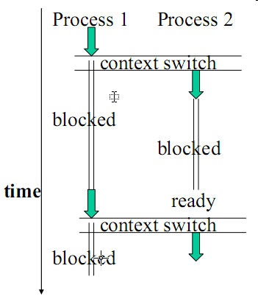
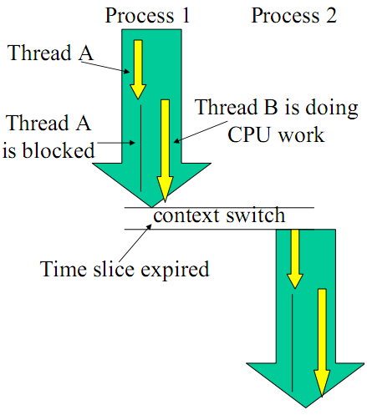
Threads Overview
It is desirable to have multiple threads of control in the same address space running in quasi-parallel, as though they were separate processes

Slide 6
Threads Models
Threads of one process (miniprocess)
Describe an sequential execution within a process
Share the same address space and resources of the process
Each thread has its own PC, registers and stack of execution
There is no protection between threads in one process
Lightweight processes (contains some properties of processes)
Have its own stack
Multithreading (multiple threads in same process)
Having multiple threads running concurrently within a process is analogous to having multiple processes running in parallel in one computer

Slide 7
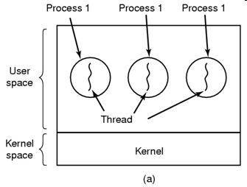
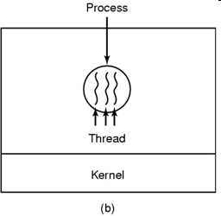
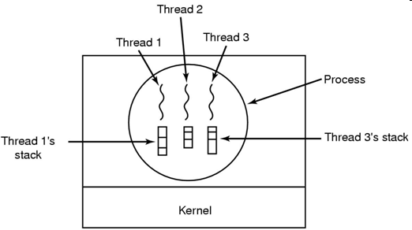
Threads Model (cont)
Tanenbaum, Fig. 2-11, 2-13.
Three processes each with one thread
Multiprogramming
One process with three threads
Multithreading
Notes:
Một tiến trình gồm nhiều luồng.
Không có process thì ko có thread

Slide 8
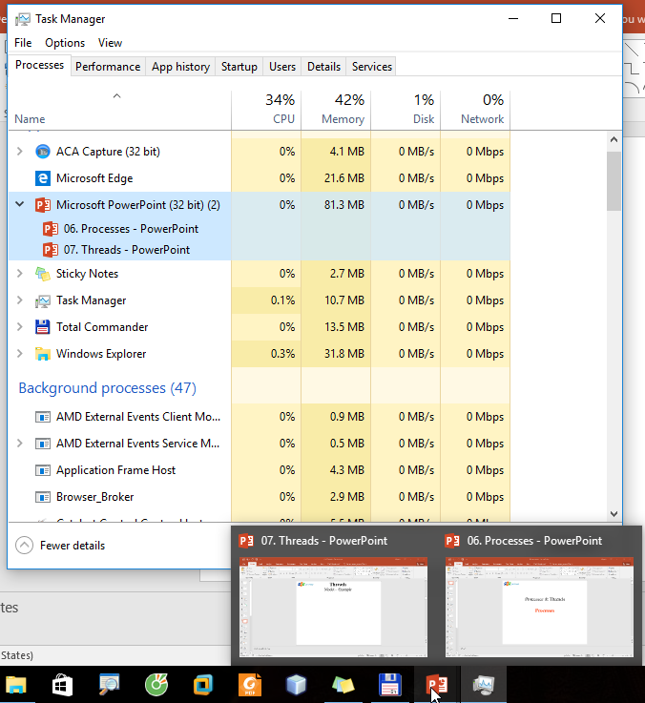
Threads Model – Example

Slide 9
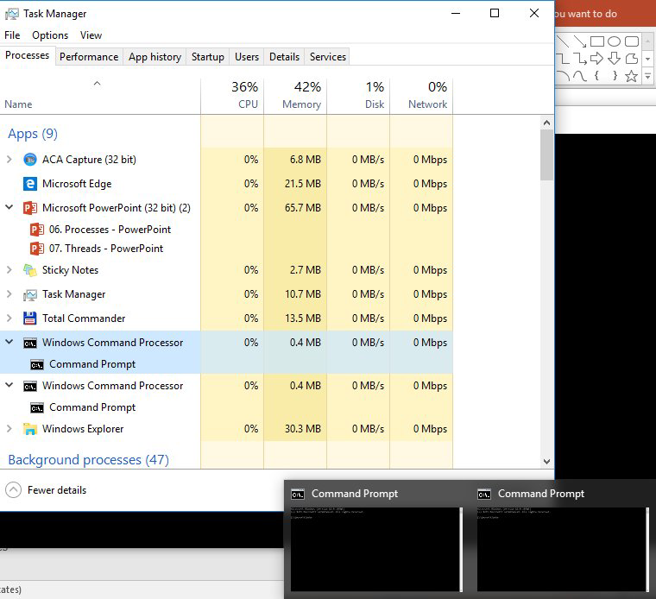
Threads Model – Example

Slide 10
Threads Benefits
Responsiveness and better resource sharing
A program may continue running even if part of it is blocked.
The application’s performance may improve since we can overlap I/O and CPU computation.
Economy:
Allocating memory and resources for process creation (faster, easier) is costly.
Thread creation may be up to 100 times faster! (Takes less time to create a new thread than a process)
Useful on systems with multiple CPUs.
Less time to terminate a thread than a process
Less time to switch between two threads within the same process (serve many task with the same purpose)
Since threads within the same process share memory and files, they can communicate with each other without invoking the kernel
But, they introduce a number of complications:
E.g., since they share data, one thread may read and another may write the same location – care is needed!

Slide 11
Threads Multithreading
Operating system supports multiple threads of execution within a single process
MS-DOS supports a single thread
UNIX supports multiple user processes but only supports one thread per process
Windows 2000, Solaris, Linux, Mach, and OS/2 support multiple threads
Multithread is effective in multiprocessors because the thread can execute in concurrently
…

Slide 12
Threads Implementing Threads in User Space
The kernel knows nothing about threads
The approach is suitable for OS that does not support threads
Threads are implemented by a user-level library (with code and data structure)
The threads run on top of a runtime system (which is a collection of procedures that manage threads)
Each process has its own thread table
Advantages
Thread switching and scheduling is faster (because it’s done at user mode) than to trapping the kernel mode
Each process can have its own customized scheduling algorithm
Scale better (can vary the table space and stack space in flexibility)
Disadvantages
The implementation of blocking system calls is complexity → instead of blocking thread, the process is blocked
The need that a thread voluntarily gives up the CPU → The OS doesn’t know this, so if any user-level thread is blocked, the entire process is blocked
The developer want threads precisely in applications → make system call constantly

Slide 13
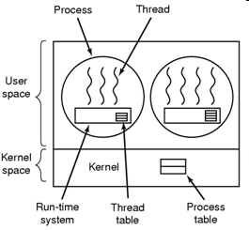
Threads Implementing Threads in User Space (cont)
Tanenbaum, Fig. 2-16.

Slide 14
Threads Implementing Threads in the Kernel
The kernel knows about the threads and manage the threads (no run-time system is needed)
The kernel schedules all the threads
The kernel has a thread table (using kernel call to create or destroy thread)
Advantages
The kernel can switch between threads belonging to different processes
No problem with blocking system calls
Useful if multiprocessor support is available (multiple CPUs)
Disadvantages
Greater cost (time and resources to manage threads create and terminate) → Solution: recycling
Thread creation, saving is slow (needs system call)

Slide 15
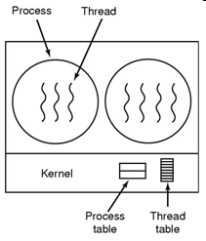
Threads Implementing Threads in the Kernel (cont)
Tanenbaum, Fig. 2-16.

Slide 16
Threads Libraries
There are 3 primitive libraries
POSIX Pthreads.
May be provided as either a user- or kernel-level library.
Win32 threads.
Kernel-level library, available on Windows systems.
Java threads.
JVM is running on top of a host operating system, the implementation depends on the host system.
On Windows systems, Java threads are implemented using the Win32 API;
UNIX-based systems often use Pthreads.

Slide 17
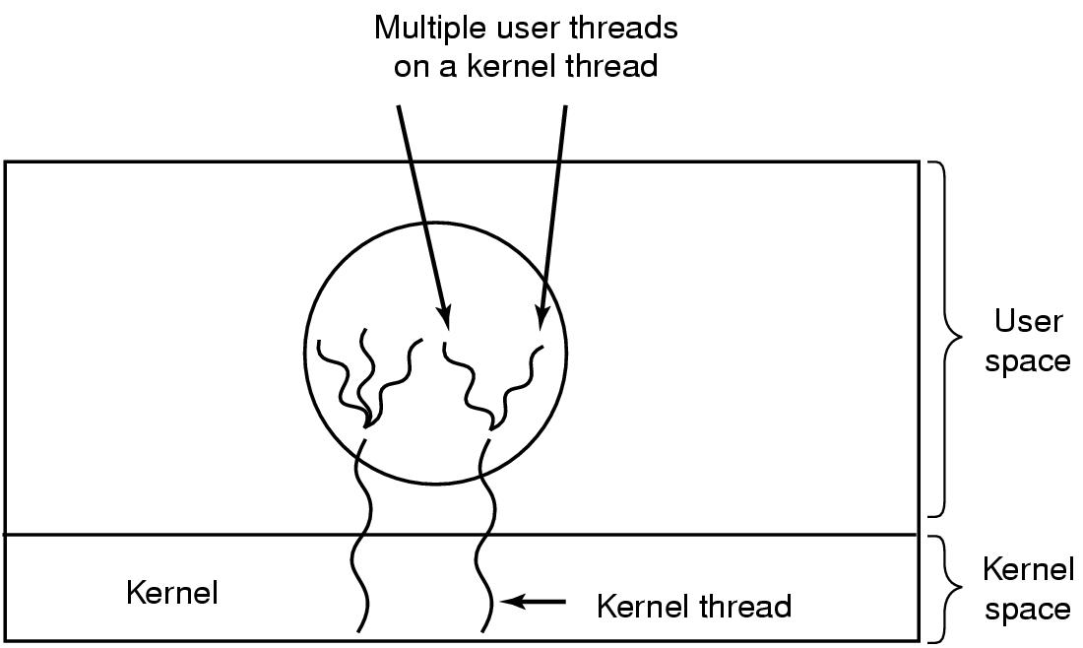
Threads Hybrid Implementations
Combine the advantages of user-level threads with kernel-level threads
Using kernel-level threads and then multiplex user-level threads onto some or all of the kernel threads (ultimate in flexibility)
Tanenbaum, Fig. 2-17.

Slide 18
Threads Scheduler Activations
Context
The kernel threads are better than user level threads but they are slower
When a thread blocks, other threads with in same process can be run
Avoiding unnecessary transitions between user mode and kernel mode
The user mode can block the thread and schedule a new one by itself
→ mimic the functionality of kernel threads and associate with threads packages implemented in user space (Scheduler Activations)
Upcall
The notified signal with information as thread’s ID and description is used to activate the runtime system
Scheduler Activation mechanism
When a thread has blocked, the kernel make the upcall to the process’s runtime system (in user mode) to inform this event
The user mode can reschedule its threads by
Marking the current thread as blocked
Taking another thread from ready list, loading and restarting it
Later, when the blocked thread, that has marked, is ready and can run again, the kernel make another upcall
The runtime system can either restart the blocked thread immediately or put in on the ready list to be run later

Slide 19
Threads Scheduler Activations
Are to mimic the functionality of kernel threads, but with the better performance and greater flexibility usually associated with threads packages implemented in user space
The kernel assigns a certain number of virtual processors to each process and lets the (user-space) run-time system allocate threads to processors
Is efficiency in reducing transition
The thread blocks waiting for another thread to do something, thus there is no reason to involve the kernel in transition

Slide 20
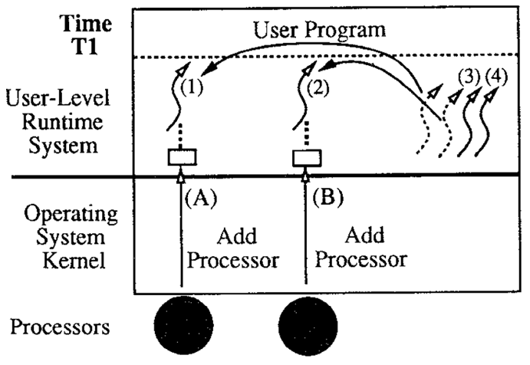
Threads Scheduler Activations – Example
T.E Anderson, Fig. 1 – Example I/O.
At time T1, the kernel allocates the application two processors. On each processor, the kernel upcalls to user-level code that removes a thread from the ready to running status.

Slide 21
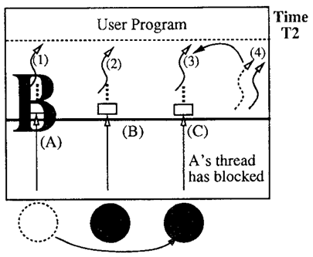
Threads Scheduler Activations – Example
T.E Anderson, Fig. 1 – Example I/O.
At time T2, one of the user-level threads (thread 1) blocks in the kernel. To notify the user level of this event, the kernel takes the processor that had been running thread 1 and performs an upcall in the context of a fresh scheduler activation. The user-level thread scheduler can then use the processor to take another thread off the ready list and start running it.

Slide 22
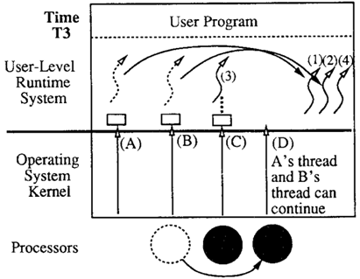
Threads Scheduler Activations – Example
T.E Anderson, Fig. 1 – Example I/O.
At time T3, the I/O completes. Again, the kernel must notify the user-level thread system of the event, but this notification requires a processor. The kernel preempts one of the processors running in the address space and uses it to do the upcall. (If there are no processors assigned to the address space when the I/O completes, the upcall must wait until the kernel allocates one). This upcall notifies the user level of two things: the I/0 completion and the preemption. The upcall invokes code in the user-level thread system that (1) puts the thread that had been blocked on the ready list and (2) puts the thread that was preempted on the ready list. At this point, scheduler activations A and B can be discarded.

Slide 23
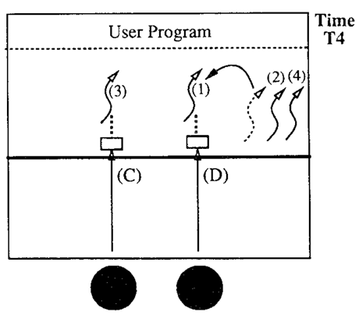
Threads Scheduler Activations – Example
T.E Anderson, Fig. 1 – Example I/O.
Finally, at time T4, the upcall takes a thread off the ready list and starts running it.

Slide 24
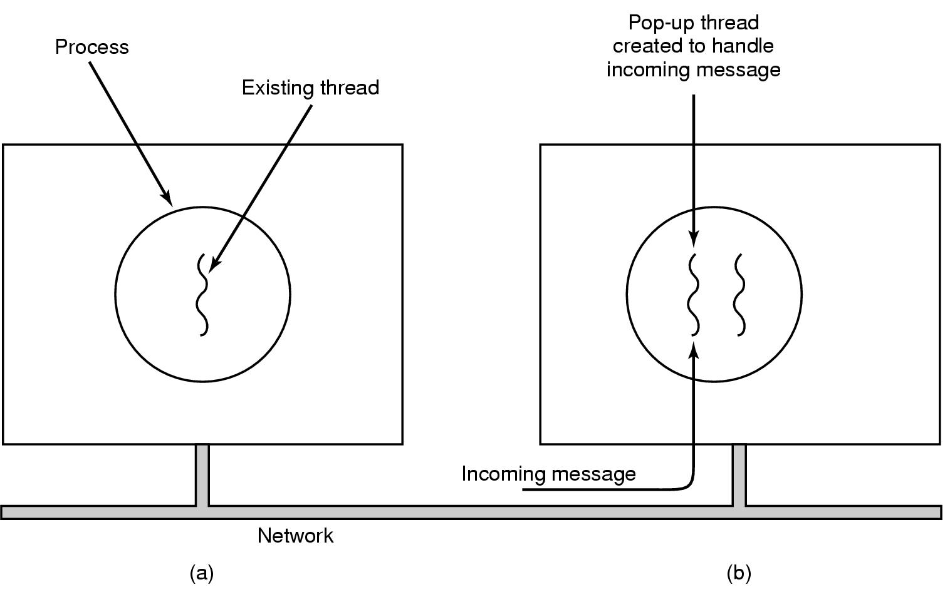
Threads Pop-Up Threads
Problem
The sender send the message to response the receiver's request
When the receiver waits the incoming message, it’s process or thread is blocked until the message arrives to process it
→ waste time to unblocked and reloaded thread information combining with unpacking the message, then parsing message’s content and processing it
Solution: using Pop-up threads
Handles the incoming message by the system creates a new thread that are brand new
This thread is identical to all the others, but it do not have any history (registers, stack, …) that must be restored
It can be implemented in kernel or user mode
Advantages
Create quickly (Do not have any threads information that must be stored)
The latency between message arrival and the start of processing can be made very short
Tanenbaum, Fig. 2-18.

Slide 25
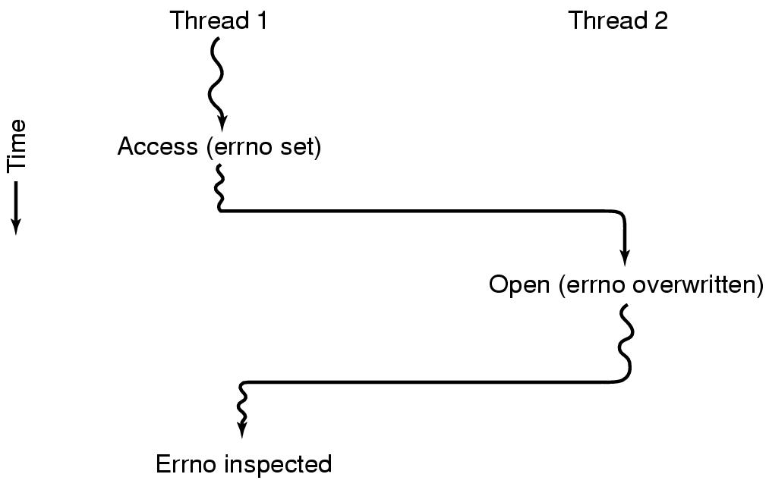
Threads Making Single-Threaded Code Multithreaded
Problem
Convert programs, that were written for single-thread processes, to multithreading
The global variables using in entire process can be a problem when the thread is used
Ex:
Tanenbaum, Fig. 2-19.

Slide 26
Threads Making Single-Threaded Code Multithreaded (2)
Solutions
Prohibit global variables altogether → conflicts with much existing software (modifying is impossible)
Assign each thread its own private global variables using private copy → allocate a chunk of memory for global variables and pass it to each procedure in the thread as an extra parameter
Use the library procedures with some methods as create_global, set_global, read_global → many library are not reentrant
Provide each procedure with a jacket that sets a bit to mark the library as in use → eliminates potential parallelism
Consider signals → are difficult to enough to manage a single threaded environment
Stack management with many stack that can be grown

Slide 27
Summary
Threads
Q&A

Slide 28
Next Lecture
InterProcess Communication

